Slide 1
Lab 1 – Introduction to Mobile Programming
Mr. Yousif Garabet Arshak
Computer Science Department
University of Zakho
yousif.arshak@uoz.edu.krd

Slide 2
Outlines
Create Console App
Syntax of C# if Statement
Syntax of C# Nested If-Else Statement
C# For & Foreach Loop
Array
Any Questions?

Slide 3
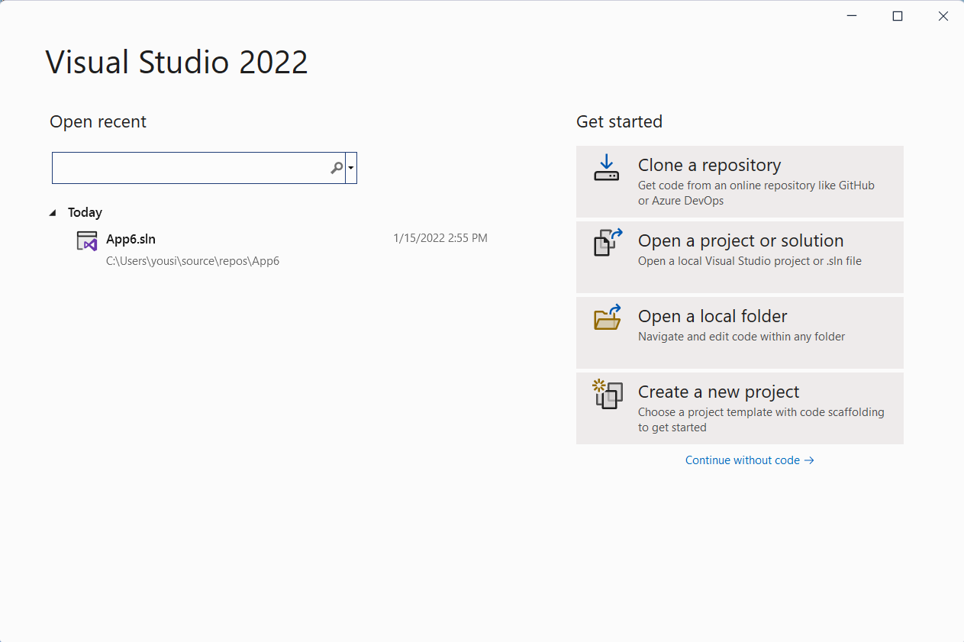
Create Console App

Slide 4
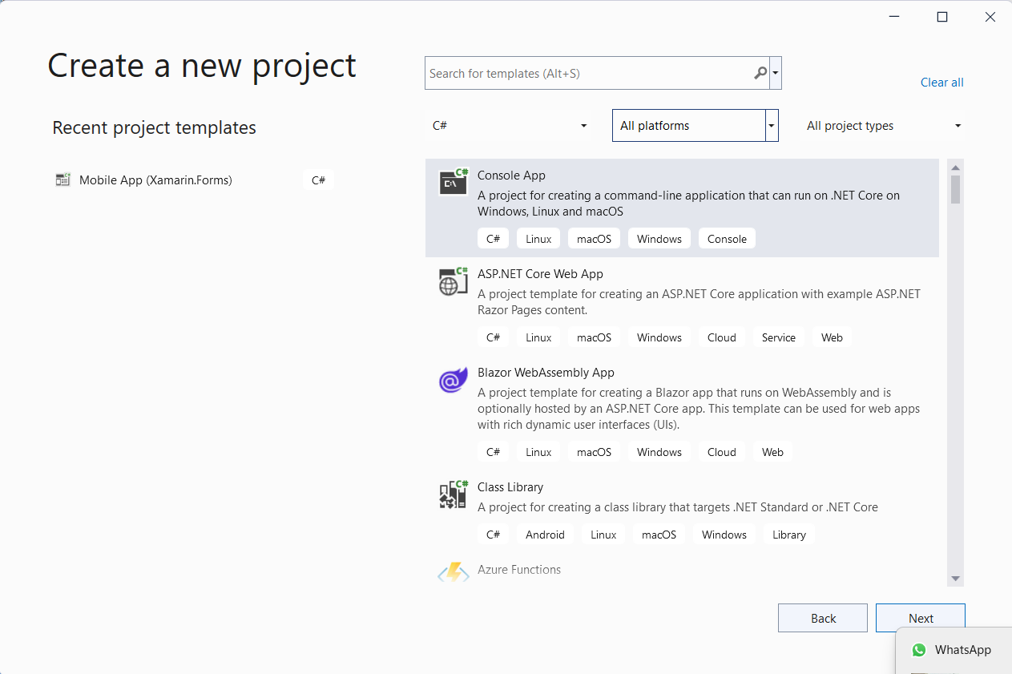
Choose Console App

Slide 5
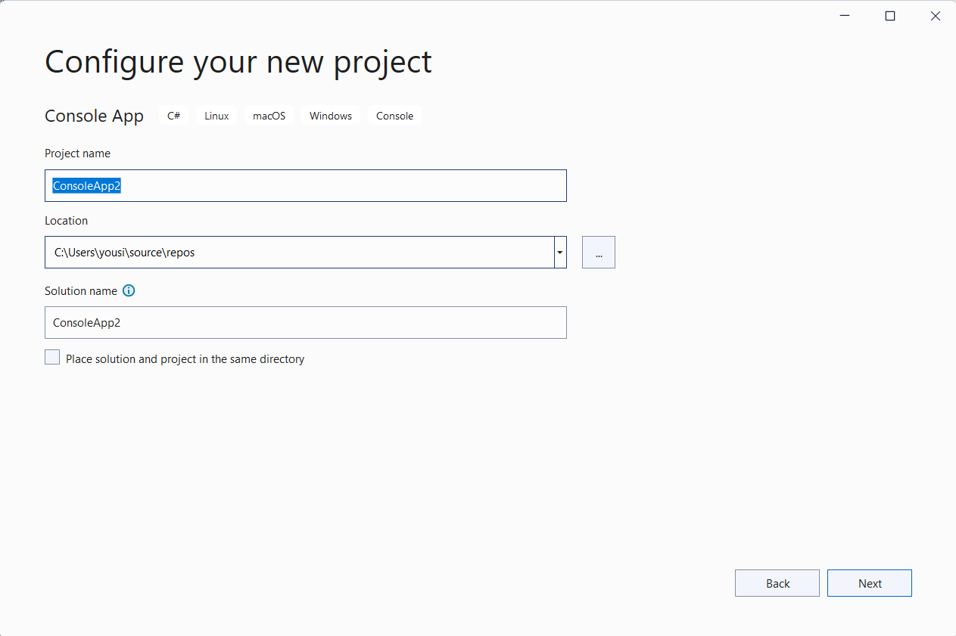
Give it a name

Slide 6
Syntax of C# if Statement
if (bool_expression) { // Statements to Execute if condition is true }
Example
int x = 20; if (x >= 10) { Console.WriteLine("Number Greater than 10"); }

Slide 7
Syntax of C# Nested If-Else Statement
int x = 5, y = 20; if (x > y) { if (x >= 10) { Console.WriteLine("x value greater than or equal to 10"); } else { Console.WriteLine("x value less than 10"); } } else { if (y <= 20) { Console.WriteLine("y value less than or equal to 20"); } else { Console.WriteLine("y value greater than 20"); } } Console.WriteLine("Press Enter Key to Exit..");

Slide 8
C# For & Foreach Loop
var names = new List<string>() { "John", "Tom", "Peter" };
// print names using for loop
for (int i = 0; i < names.Count; i++)
{
Console.WriteLine(names[i]);
}
// print names using foreach loop
foreach (string name in names)
{
Console.WriteLine(name);
}

Slide 9
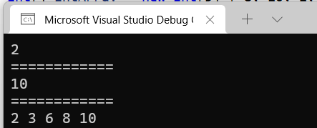
Array
int[] intArray = new int[5] { 8, 10, 2, 6, 3 };
// Find minimum number
Console.WriteLine(intArray.Min());
Console.WriteLine("============");
// Find maximum number
Console.WriteLine(intArray.Max());
Console.WriteLine("============");
// Sort Array
Array.Sort(intArray);
// write array
foreach (int i in intArray)
Console.Write(i + " ");

Slide 10

sort string array
// sort string array
string[] stringArray = new string[5] { "X", "B", "Z", "Y", "A" };
Array.Sort(stringArray);
// write array
foreach (string str in stringArray) Console.Write(str + " ");

Slide 11

Any Questions?

